Slide 1
Identification of Sky Regions in a Photo

Slide 2
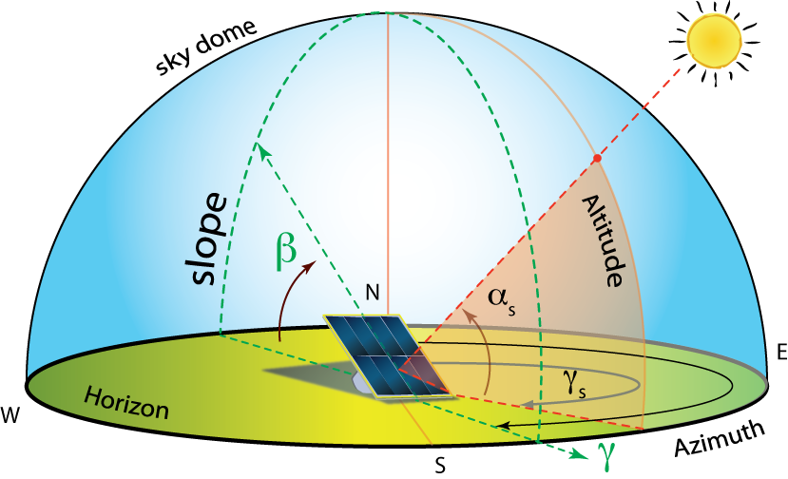
Description (Problem NM381)
Generating local sky horizon has important applications for analysis of solar energy potential in an urban setting. Develop a mobile application for automatically detecting sky pixels in a photograph. The application should generate a mask image consisting of sky pixels marked in white color in the image and other pixels marked in black color. Further, using information about camera optics, the application should give angle of elevation of the lowest sky pixel for all pixel columns in the mask image.
Use case: Determining feasibility of solar panels and optimization.

Slide 3


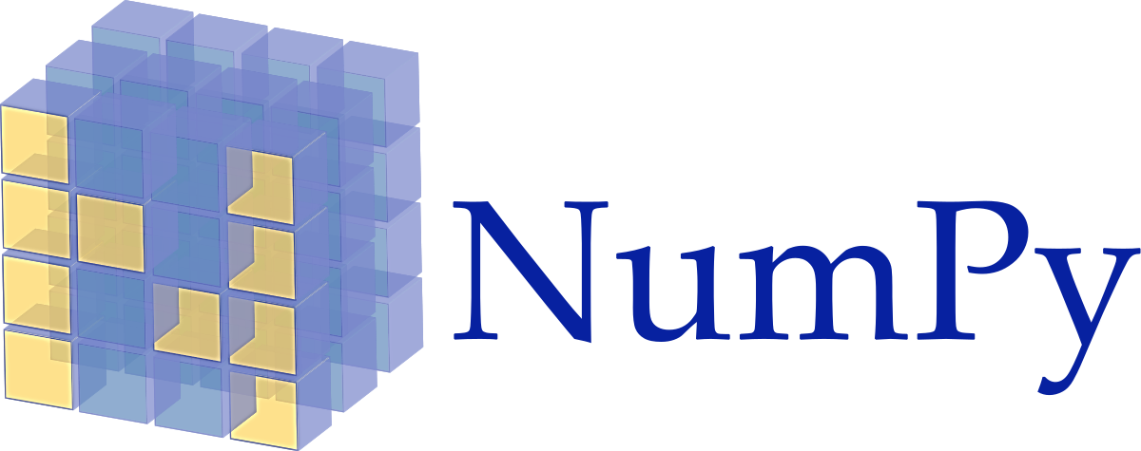
Hardware and Software
Hardware
Camera Module
Programming Language
Python -
Software Techniques
Open Source Computer Vision (OpenCV)
NumPy
Sobel Operator for Edge Detection
Sobel Operator
for Edge Detection

Slide 4
Flowchart (Work Proposed for the Day)
Sky Detection
Gradient Image Calculation using Sobel Operator
Preliminary Sky Region Detection
Sky Region Refinement and Post-Processing
Image Masking
Camera
Sky Detection
Total Sky Area Exposure Calculation

Slide 5
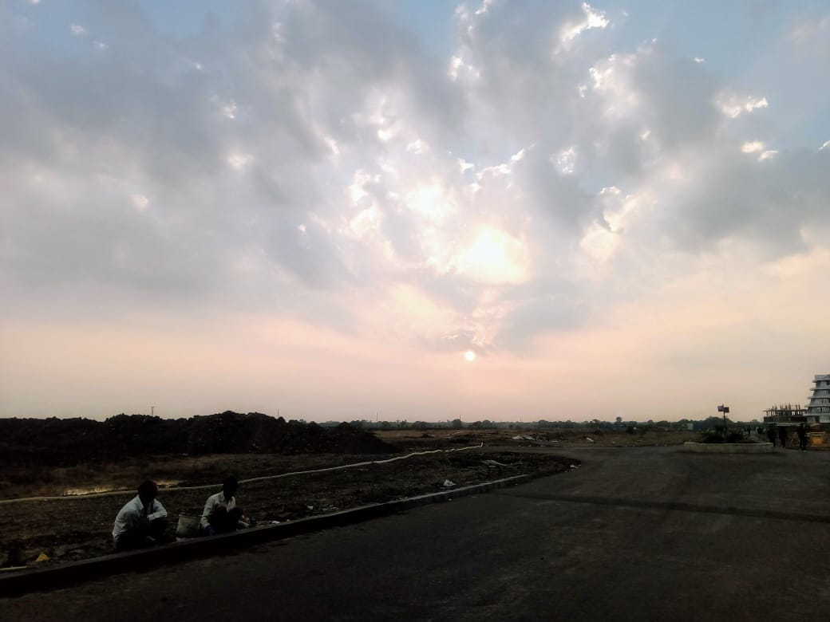
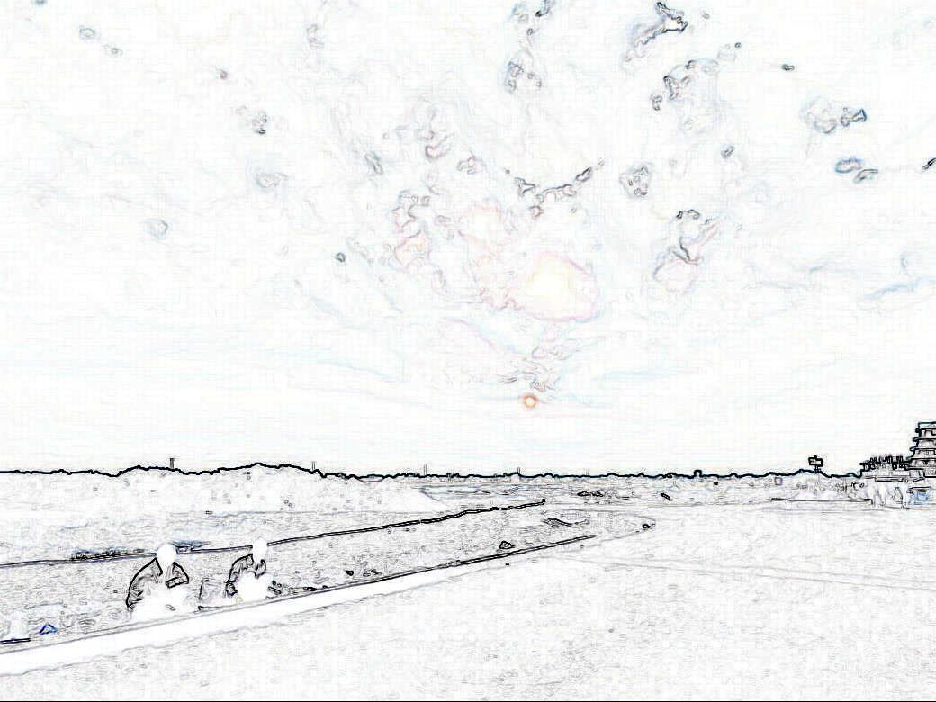
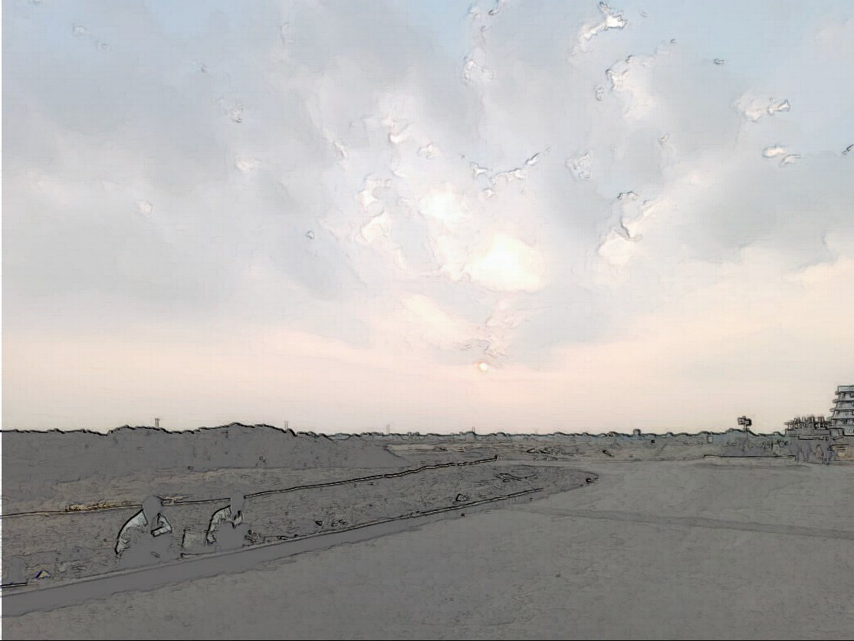
Image Pre-Processing
Steps Involved:
Converting RGB image into greyscale.
Converting greyscale image into gradient image with Sobel Operator (for image processing and edge detection).
Two images hence obtained with horizontal and vertical gradients are superimposed to obtain border of every object in the coloured image.
Original
Pre-Processed
Superimposed
* To get better results image filters have been applied. This helps to reduce noise in the image.

Slide 6
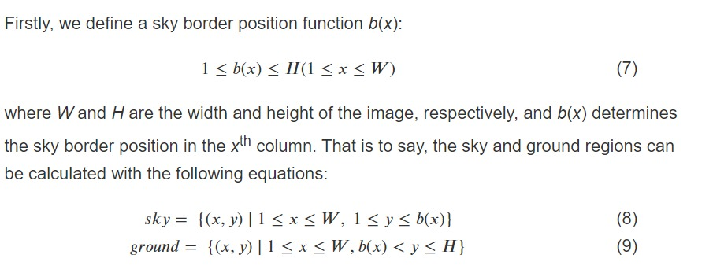
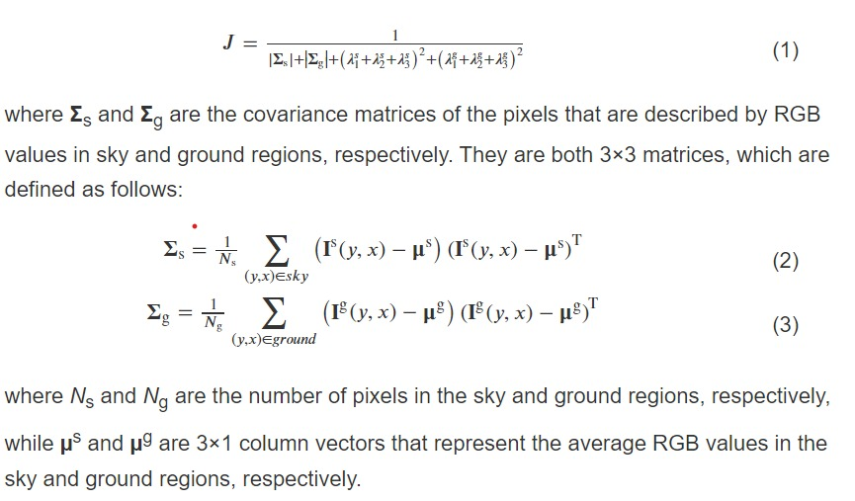
Preliminary Sky Region Detection
Mathematical Modelling
To distinguish between sky and ground we use Energy Function, the original colour image is divided into sky and ground regions. The pixels in both regions are denoted by RGB components. The energy function defined is as follows:
The sky and the ground colour signatures will hence help us to distinguish between sky and ground regions.

Slide 7
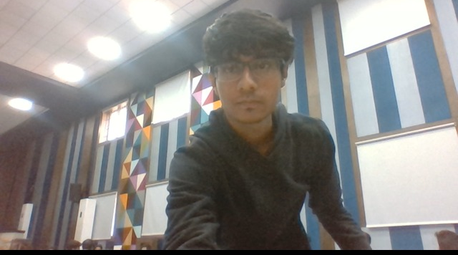
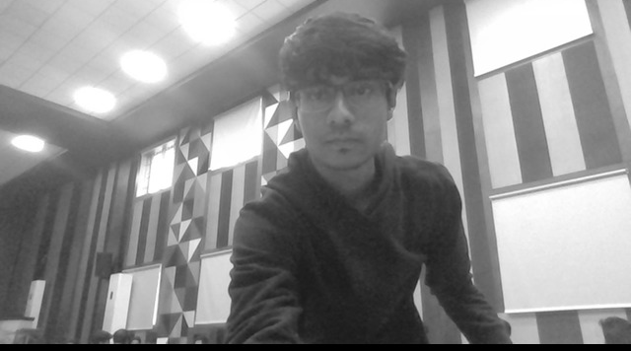
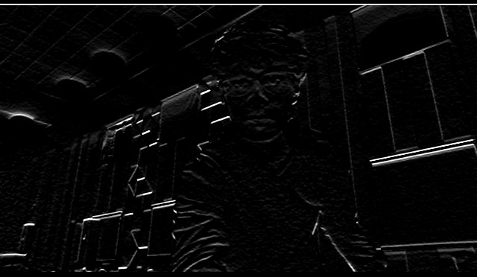
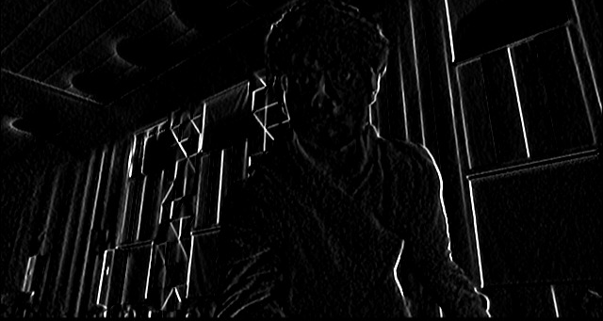
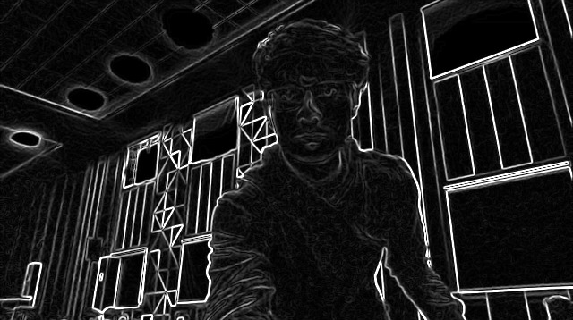
Live Experiment (Implementation for border masking)
Original
Greyscale
Horizontal Gradient
Vertical Gradient
Superimposed(Horizontal and Vertical)

Slide 8
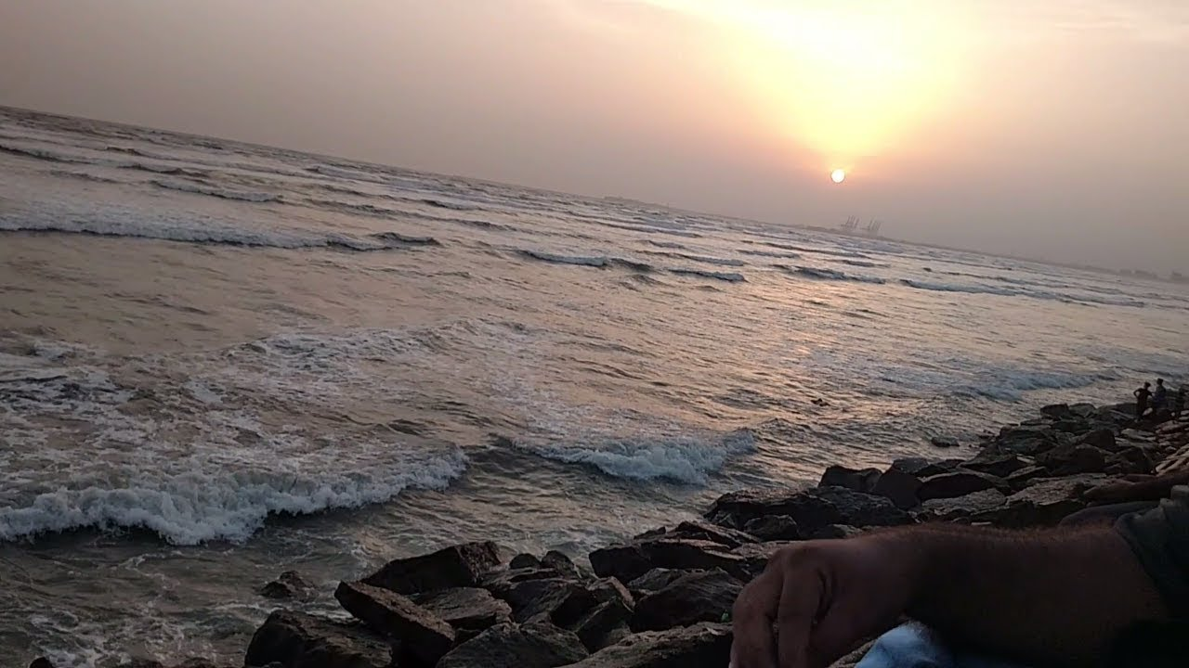
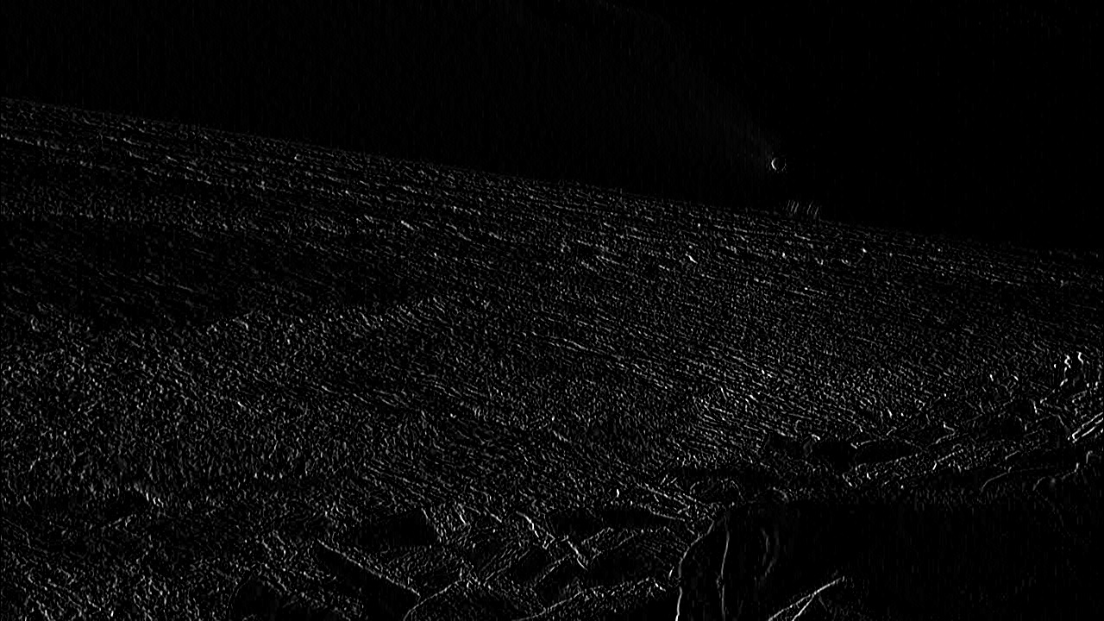
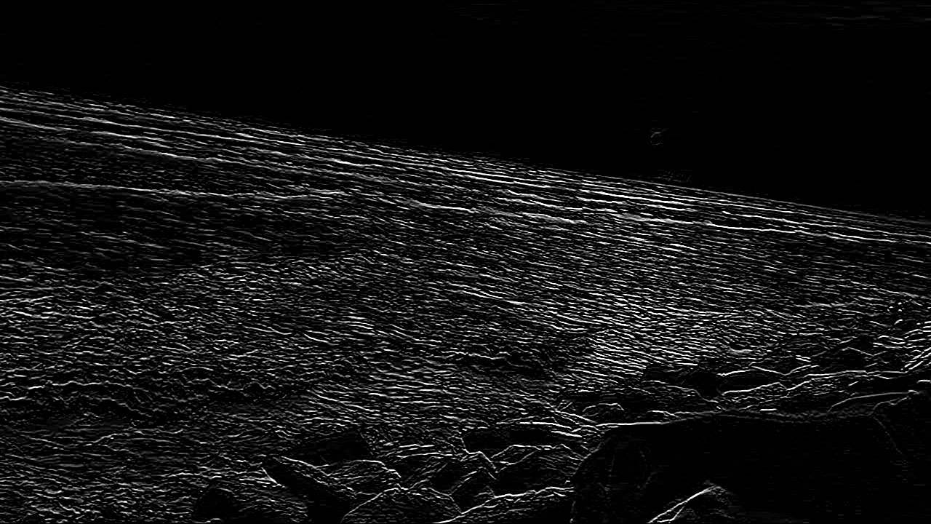
Suggested Edits
Implementations/Corrections
1. Distinguish Between Sky and the Ground.
2. Differentiate between Sky and the Sea.
3. Measure intensity of light from the sky.
1. Mathematical Modelling of technique to differentiate sky and ground and hence implemented.
2. Refined algorithm to detect ripples in the moving water by making the image sharper and thus differentiate it from the smooth sky.
3. If the image is taken in an area where sufficient amount of light is unavailable, it will show low light error.

Slide 9
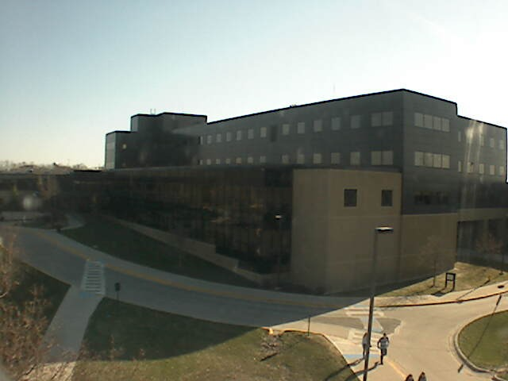
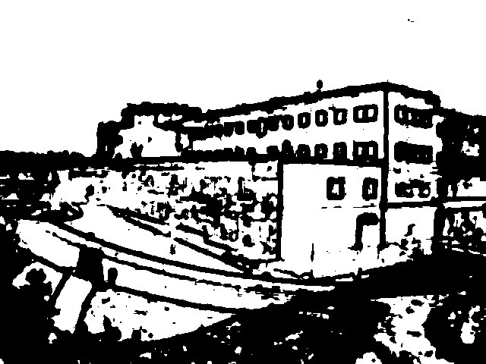
Limitations
1. Does not work on over exposed or blur images.
2. Does not work after daytime.
3. Inaccurate inside any medium such as water or glass.

Slide 10
Thank You
Team 1D345
Prayag Bhatnagar 18BCE10196
Hritvik Semwal 18BCG10048
Shreeyash Jejurkar 18BCE10254
Kritika Shah 18BCE10145
Aditya Yadav 18BCE10015
Mihir Semwal 18BCY10054

